Slide 1
Smart Water Tank
Project By:
Kushboo Jain.
Mrunal Khivasara.
Suraksha Sanghavi.
Shamal Bedmutha.
TE(Comp.)

Slide 2
Abstract :
This circuit is designed to determine the water level especially in Water Tank.
As the water level decreases from the particular level then motor will automatically ON
As the water level increases from the particular level then motor will automatically OFF

Slide 3
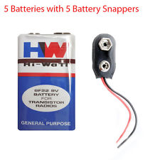
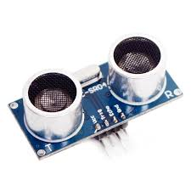
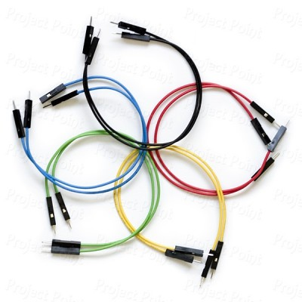
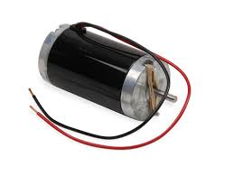
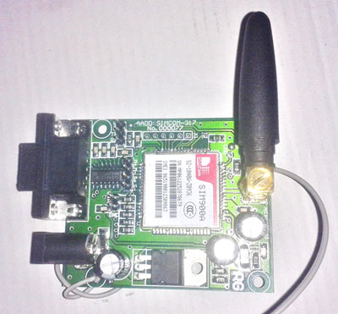
Components:
Following are the required components for making water level indicator circuit:
1. UltraSonic Sensor
2.5V DC battery
3. Connecting wires
4.DC Motor
5.GSM Modem

Slide 4
Component Details:
1.Ultrasonic Sensor:
Ultrasonic Sensors are widely used in Robo projects for Distance measurement as well as Obstacle detector
2.DC Motor:
A motor is an electrical machine which converts electrical energy into mechanical energy.

Slide 5
3.Connecting Wires:
Few connecting wires are used for connection in the circuit.
4. Power Supply:
A DC power supply of about 5V is taken.
5. GSM Modem:
GSM is a mobile communication modem; it is stands for global system for mobile communication (GSM).

Slide 6
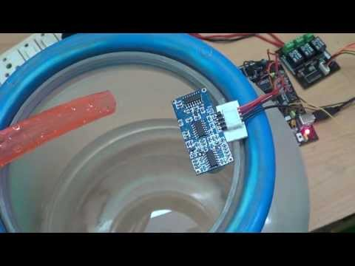
Circuit Diagram :

Slide 7
Working:
The operation of this project is very simple and can be understood easily. In our project “Smart Water Tank” there are 3 main conditions:
There is no water available in the source tank.
There is ample amount of water available in the source tank.
So let us discuss on the more about these 3 conditions

Slide 8
Condition 1:Water is not available
When the tank is empty there is automatically motor will on with the help of UltraSonic Sensor

Slide 9
Condition 2:Tank is full
When the tank is full then motor will
automatically
off with the help of UltraSonic Sensor

Slide 10
Condition 3:Intermediate levels
Now as the water starts filling in the tank a conductive path is established and it gives message on mobile with the help of GSM modem Sensor.
When tank is filled halfly then it gives msg that tank is filled 50%

Slide 11
Application:
Automatic Water level Controller can be used in Hotels, Factories, Homes Apartments, Commercial Complexes, Drainage, etc.,
Automatic water level controller will automatically START the pump set as soon as the water level falls below the predetermined level (usually 1/2 tank) and shall SWITCH OFF the pump set as soon as tank is full.
Fuel level indicator in vehicles.
Liquid level indicator in the huge containers in the companies.

Slide 12
Thank You

